Slide 1
INTERNET PROGRAMMING AND MOBILE DEVELOPMENT Task-2: Requirement Gathering
Design and Implementation of a Road Sign and Road State Mobile Notification Application.
GROUP 4
Supervisor: Dr NKEMENI Valery

Slide 2
Outline
Introduction
Project Objectives
Steps Involved In Requirement Gethering
When is Requirement Gathering Done

Slide 3
Introduction
Enhance driver safety with our mobile app.
Our solution tackles the limitations of current traffic systems by providing up-to-date information on road signs, dangers, and construction.
Using phone technology, live data, GPS, and driver reports, our app delivers the most relevant information for a safer driving experience. Experience improved safety with our innovative solution.

Slide 4
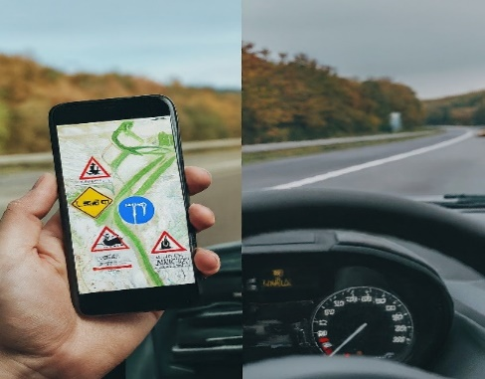
Project Objectives
The project aims to create a user-friendly mobile application for drivers.
The application will provide access to road sign information and real-time updates on road conditions.
It will feature a responsive interface optimized for smartphones and tablets.
A database of road signs on major highways will be incorporated into the application.
Users will receive instant information about the meaning and significance of road signs they encounter.

Slide 5
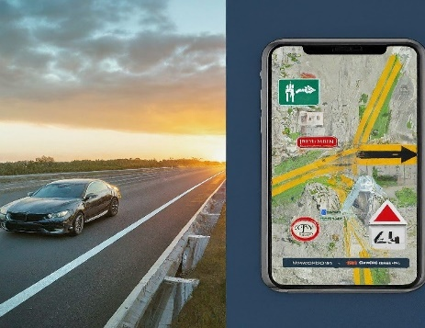
Project Objectives
Real-time data sources such as traffic cameras, weather sensors, and crowdsourced reports will be leveraged.
Users will receive timely updates on road conditions, including traffic congestion, accidents, weather-related hazards, and road closures.
Customizable notification preferences will allow users to receive alerts based on their specific preferences and travel requirements.
The application will seamlessly integrate with popular navigation systems and mapping platforms.
Users will be able to access road sign information and updates within their preferred navigation app.

Slide 6
Steps Involved In Requirement Gethering
Step 1: Preparation
Step 2: Gathering Requirements
Step 3: Refining Requirements
Step 4: Approval and Baselining
Step 5: Ongoing Management

Slide 7
Why is Requirement Gathering Done
Defines Direction
Minimizes Risks
Improves Efficiency
Enhances Satisfaction

Slide 8
How is Requirement Gathering Done
Brainstorming
Interviews
Questionnaires
Prototypes
Document Review

Slide 9
Requirement Gathering Tools
Communication and Collaboration Tools:
Meeting Software:
Platforms like Zoom, Google Meet, or Microsoft Teams facilitate online meetings with stakeholders (drivers, traffic authorities, etc.) to discuss needs and pain points.
Project Management Software:
Tools like Asana, Trello, or Monday.com help organize discussions, store notes, and collaborate on drafts with stakeholders

Slide 10
Requirement Gathering Tools
Documentation and Feedback Tools:
• Document Sharing Platforms:
Cloud storage services like Google Drive or Dropbox allow sharing documents (surveys, mock-ups) with stakeholders for feedback and version control.
• Mind Mapping Software:
Tools like Miro or Mind Meister help visually represent user flows, brainstorm ideas, and organize requirements collaboratively.

Slide 11
Types of Requirements Gathering
Solution Requirements:
This translates to the app's features and technical specifications:
Functional Requirements:
The app must display road signs, offer real-time traffic information, and allow users to report incidents.
Non-Functional Requirements
The app should be user-friendly, operate reliably, and be compatible with various devices

Slide 12
Types of Requirements Gathering
Stakeholder (User) Requirements:
Drivers:
Need real-time updates on accidents, construction zones, and weather conditions. They might also want features like navigation assistance or hands-free reporting capabilities.
State Agencies:
Might need the app to integrate with existing traffic monitoring systems and allow for quick updates on road closures or hazards.
These needs would bridge the gap between the high-level business goals and the specific functionalities of the app.

Slide 13
Functional Requirements Breakdown for a Road Sign and Road State Application
1. Road Condition Monitoring:
• Data Sources:
• Data Collection Methods
2. Data Aggregation and Processing
• Data Validation and Cleaning
• Data Fusion

Slide 14
Functional Requirements Breakdown for a Road Sign and Road State Application
3. Real-time Updates:
Update Frequency
Delivery Methods
4. Incident Detection and Reporting:
Automated Detection
User-reported Incidents
Integration with Emergency Services

Slide 15
Functional Requirements Breakdown for a Road Sign and Road State Application
6. Historical Data Analysis:
Data Storage
Data Analysis Tools
7. User Feedback and Collaboration:
Feedback Mechanisms
Community Reporting

Slide 16
Non- functional Requirements Breakdown for a Road Sign and Road State Application
Performance
Responsiveness
Low Latency Notifications
Battery Efficiency
Usability
Intuitive Interface
Minimal Distraction
Voice Control Options

Slide 17
Non- functional Requirements Breakdown for a Road Sign and Road State Application
Security
User Privacy:
Data Security:
Data Management:
Road Sign Information Source:
Real-time Data Acquisition:
Data Update Mechanism:

Slide 18
System Requirement Specification (SRS) Document.

Slide 19
Introduction
A comprehensive database of road sign definitions and meanings.
Real-time updates on traffic conditions, accidents, and weather hazards.
Personalized notification preferences based on user needs.
Seamless integration with popular navigation apps.

Slide 20
Specific Requirements
Road Sign Information
For each road sign, the application shall display a clear and concise definition of its meaning and significance.
The application shall include visual representations (icons or images) for each road sign to aid in identification.
The application may offer functionalities like voice descriptions of road signs for users with visual impairments.

Slide 21
Specific Requirements
Real-time Updates
The application shall integrate with real-time data sources, including traffic cameras, weather sensors, and crowdsourced reports.
The application shall display traffic congestion information on a map, with clear indications of severity levels and estimated delays.
The application shall provide alerts about accidents, road closures, and weather hazards (e.g., flooding, fog, icy roads) relevant to the user's location or planned route.
The application shall allow users to define notification preferences for alerts based on severity, type (accident, closure, etc.), and geographical area.

Slide 22
Specific Requirements
Navigation Integration
The application shall integrate seamlessly with popular navigation apps and mapping platforms (specify target apps if known).
The application shall share road sign information and real-time road state data with navigation apps through a documented API.
The application shall allow users to access road sign information and real.

Slide 23
External Interface Requirement
User Interfaces
Smartphones and Tablets: These are the primary hardware platforms where the app runs. The app interacts with the device's functionalities like:
Operating System (OS): The app needs to be compatible with the target OS, most likely Android or iOS.
GPS: The app uses the device's GPS hardware to determine the user's location, allowing it to display relevant road sign information and real-time road state data.
Internet Connectivity: The app relies on internet connectivity to access real-time data sources (traffic cameras, weather sensors) and potentially download updates.
Display: The app utilizes the device's display to present road sign information, real-time road state data, and notifications to the user.
Speaker/Audio Output: The app might use the device's speaker to deliver audio notifications about road conditions or alerts.

Slide 24
External Interface Requirement
Software Interfaces
1. Programming Language
2. Integrated Development Environment (IDE)
3. Design Tools
4. External APIs and Data Sources
5. Version Control System

Slide 25
External Interface Requirement
Hardware Interfaces
1. User Devices
2. External Data Sources (Indirect Hardware Involvement):

Slide 27
Quality Attributes
5.1 Non-Functional Requirement
Performance
Responsiveness
Low Latency Notifications
Battery Efficiency

Slide 28
Quality Attributes
5.1 Non-Functional Requirement
Usability:
Intuitive Interface:
Minimal Distraction:
Voice Control Options (Optional):

Slide 30
Road sign, State and Notification app
Road sign Information
Database
Registration
Registration form
Real-time Update
Real-time data (Traffic camera)
Confirm Email
UI
Design maps to display traffic congestion
Functional Decomposition

